Slide 1

TruthChain
Team: USTLab
Blockchain Based
Genuine Information.

Slide 2
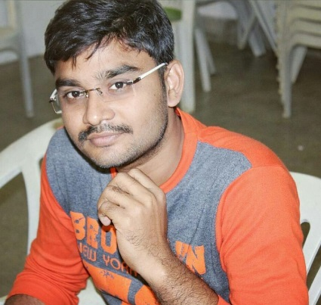
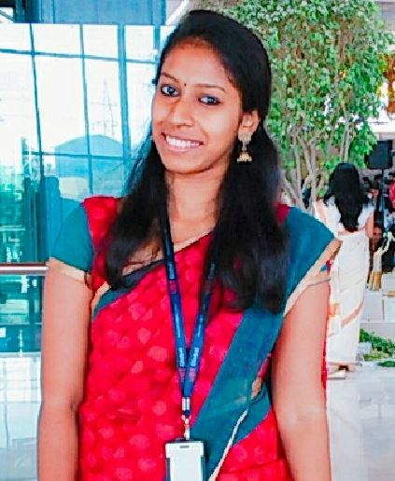
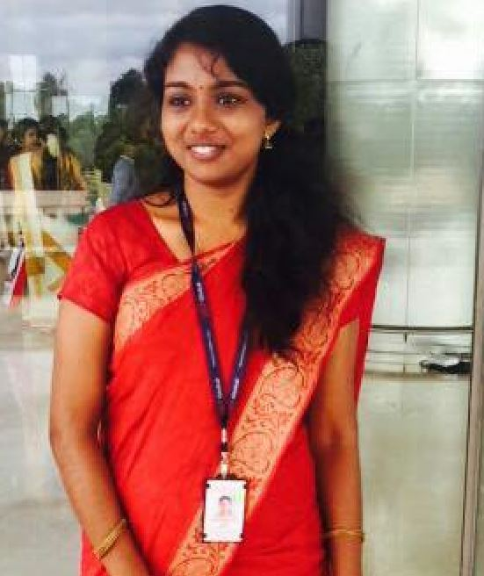
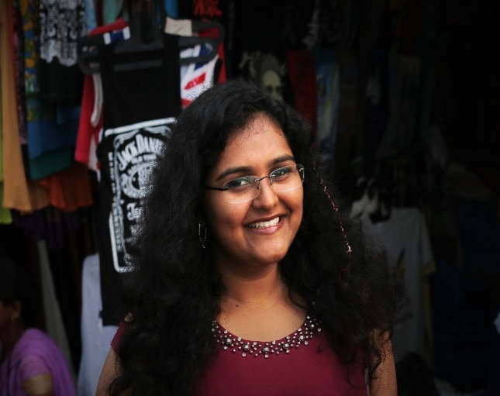
Our Team
Team Lead
Aparna Prem
Sales Innovation
UID: U52175, Infinity Labs
Sethulekshmi
Sales Innovation
UID: U52176, Infinity Labs
Narendranath Reddy Thota
Trainer, Gama
Software Developer (Blockchain, Node JS, Java, Solidity)
UID: U54886, MAERSK
Prerna
Infinity Labs
UID: C58733,
2

Slide 3
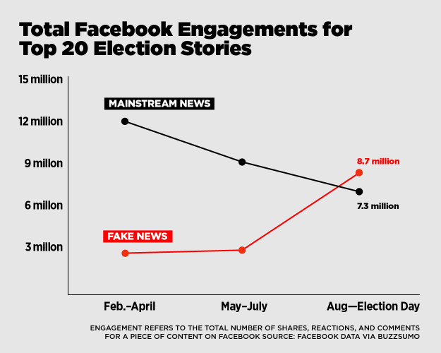
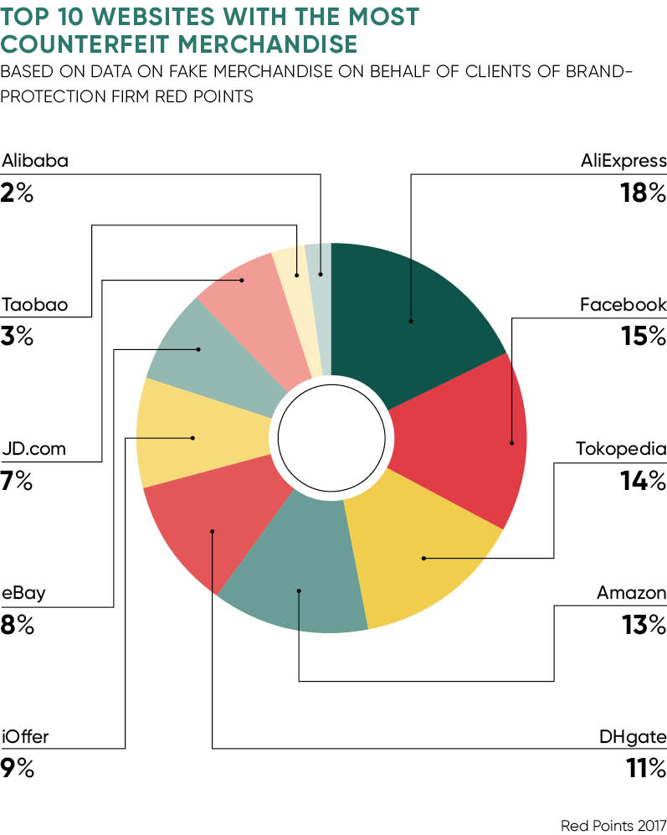
Fake Content
Influence of Fake Information

Slide 4


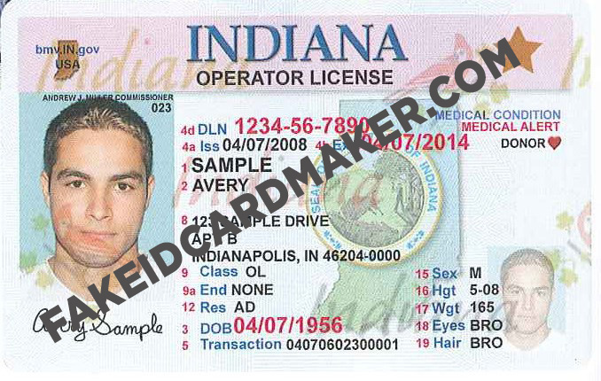
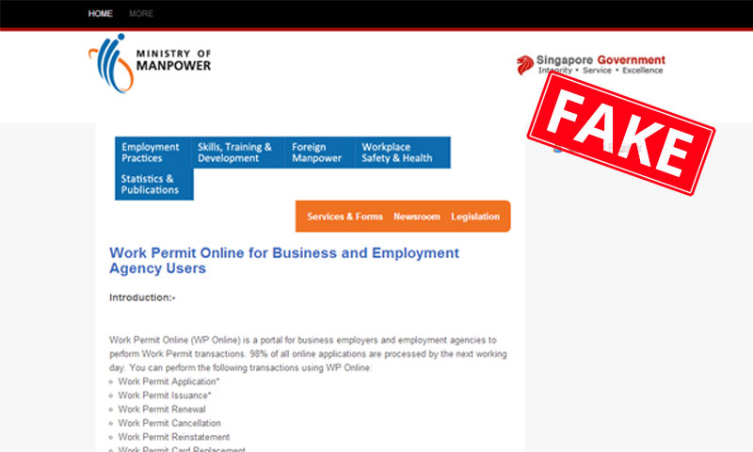
Fake Content
And the list goes on…

Slide 5


TruthChain Engine
The Solution : TruthChain - Engine
TruthChain
Engine
Information
Fake Information
Genuine Information

Slide 6






Use Case NEWS Articles
How TruthChain works
WWW
₊
Information
REVIEWER COMMUNITY
READER
WRITER

Slide 7





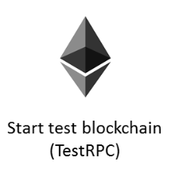


Technology Architecture
UI
CSS
Bootstrap
HTML
Handlebars JS
Backend
NLTK-Python
Web3.js
RPC
EVM(Ethereum Virtual Machine
Block1
Block2
Block3
Block4
Block5
Block N
Blockchain
Notes:
Who is going to be the target market - customer demographics, purchasing habits, buying cycles, and willingness to adopt the solution? Is there a viable market? How will the product make money? What is your competitive readiness to realize unmet customer needs.

Slide 8

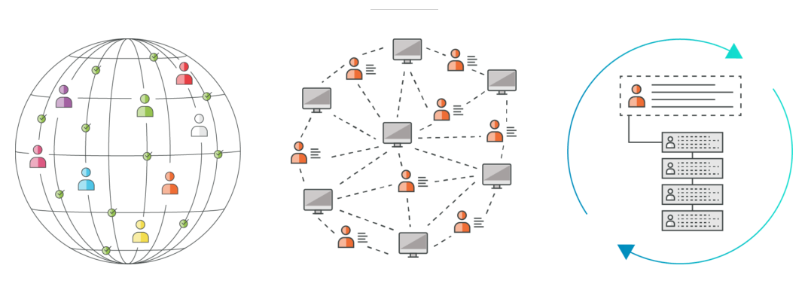
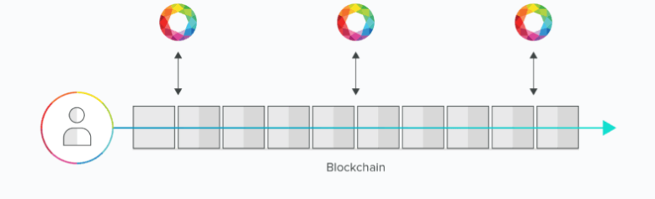
Use Case NEWS Articles
Why Blockchain
Trust
Integrity
Labeling(fake/genuine)
Prevent Unauthorized access
In-corruptible
Decentralized
7

Slide 9

Demo
13

Slide 10
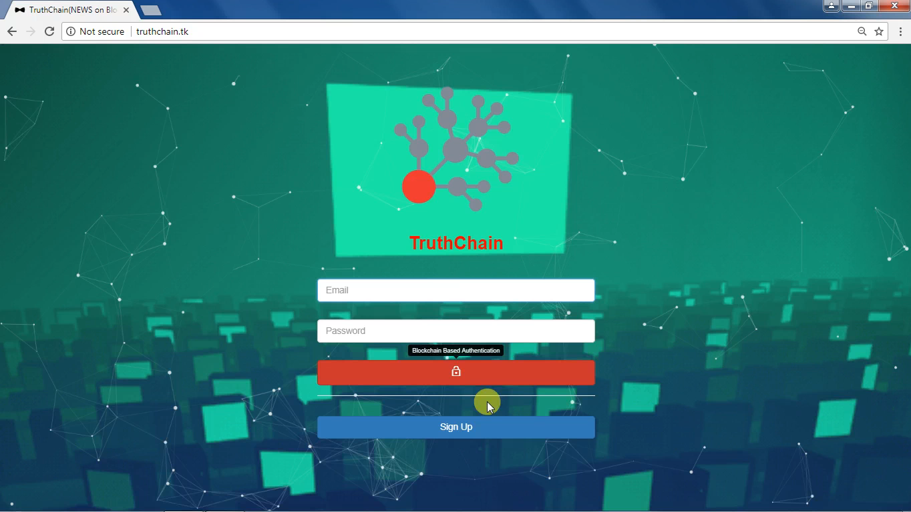

Slide 11
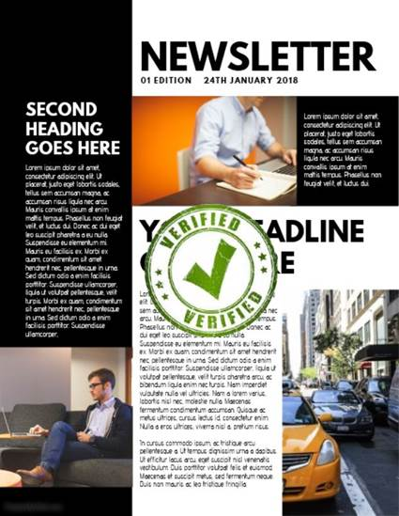

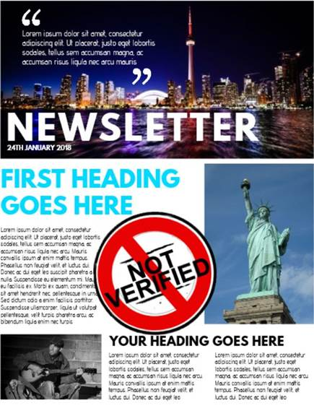
Conclusion NEWS Articles
Conclusion : No more Fake News
14

Slide 12



Conclusion TruthChain Engine
Conclusion (TruthChain-Engine) : The next best stop for the Truth

Slide 13
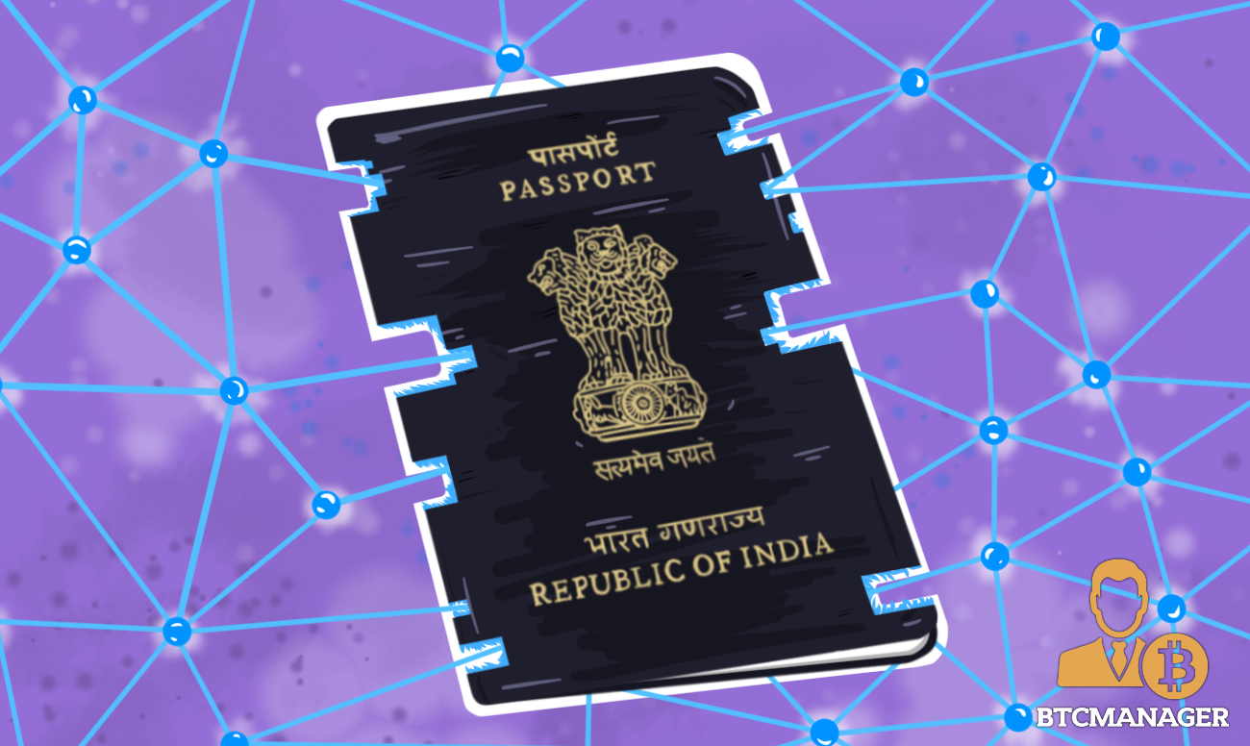
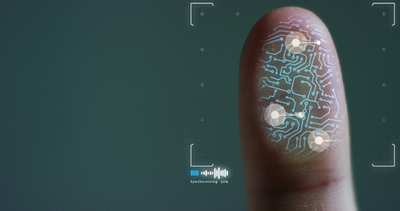

TruthChain Capabilities
Many More..
Virtual Passport
To Eliminate Fake Passports in the Digital world. Writer: Indian Passport Seva Kendra Reviewer: Indian Ministry Of External Affairs Reader: Digital World
Police Identity & Criminal Evidence
To Eliminate Fake Police Officers and Fake Evidence. Writer: Sub-inspector Rank Reviewer: SP Rank Reader: Police Department Content: Police Identities, Evidence – Fingerprints, Snapshots, FIR

Slide 14

Road Map
The Road Ahead

Slide 15

Q ? And A!
15

Slide 16


We appreciate your interest in UST Global
THANK
YOU
Address
Phone
E-mail
5 Polaris Way
Aliso Viejo, CA 92656
Tel: 949. 716. 8757
Fax: 949: 716. 896
Contact@ust-global.com

